Slide 1

Customer Segmentation model for a Airtel Company
Presented by:- Shahzad Sheikh
Business Analysis

Slide 2
Content
What are the Customer Segmentation?
Objective of Customer Segmentation.
Introduction of Aritel telecommunication.
Requirements of Airtel.
Telecommunication Company

Slide 3
What are the customer Segmantation ?
Customer segmentation analysis is the process performed when looking to discover insights that define specific segments of customers. Marketers and brands leverage this process to determine what campaigns, offers, or products to leverage when communicating with specific segments.

Slide 4
What are the Customer Segmentation ?
Geographical
Democracy
Behaviour
Dencity of Area
Psychographic

Slide 5



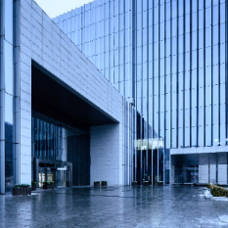
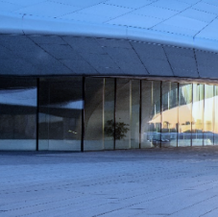
Classification of Segmentation
Geographical
Dencity of Area
Democracy
Psychographic
Behaviour
–
Region wise ( Telecom Circles )
•
Metro Circles : Cities of Delhi, Mumbai, Kolkata
•
A Circles : Andhra Pradesh, Gujarat, Karnataka, Tamil
Nadu, Maharashtra
B Circles : Haryana, Kerala, Madhya Pradesh, WestBengal, UP (East), UP(West).
•
C Circles : Assam, Bihar, Himachal Pradesh, Northeast,Orissa.
* As per Indian Department of Telecommunications
•
Urban (Cities Such As Mumbai, Delhi, Kolkata, Chennai
etc.)
•
Rural (Baramati, Khed, Saswad etc.)
Age and lifecycle:
From age group 15 to 24
•
25 and above
•
Senior citizens
–
Gender
–
Generation
Income
Prepaid
Postpaid
Lifestyle
–
Personality
Brand loyalty
–
Occasions
–
Benefits

Slide 6



Objective of Customer Segmentation
Understand Customer
Develop New Product
Segmentation
Improve Sales
Target Customer
Create Prosonafication
Improve Marketing

Slide 7
AIRTEL Communication
Bharti Airtel Limited is an Indian multinational telecommunications services company based in New Delhi. It operates in 18 countries across South Asia and Africa, as well as the Channel Islands. Currently, Airtel provides 5G, 4G and LTE Advanced services throughout India. Currently offered services include fixed-line broadband, and voice services depending upon the country of operation. Airtel had also rolled out its Voice over LTE (VoLTE) technology across all Indian telecom circles. It is the second largest mobile network operator in India and the second largest mobile network operator in the world. Airtel was named India's 2nd most valuable brand in the first ever Brandz ranking by Millward Brown and WPP plc.

Slide 8

Product or service profile
Mobile Service
Airtel fiber and dish TV
Product Cycle
Network,3G , 4G, 5G
Airtel Money
Digital TV Service
Airtel Live

Slide 9
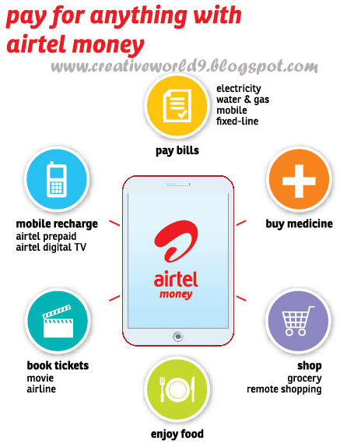
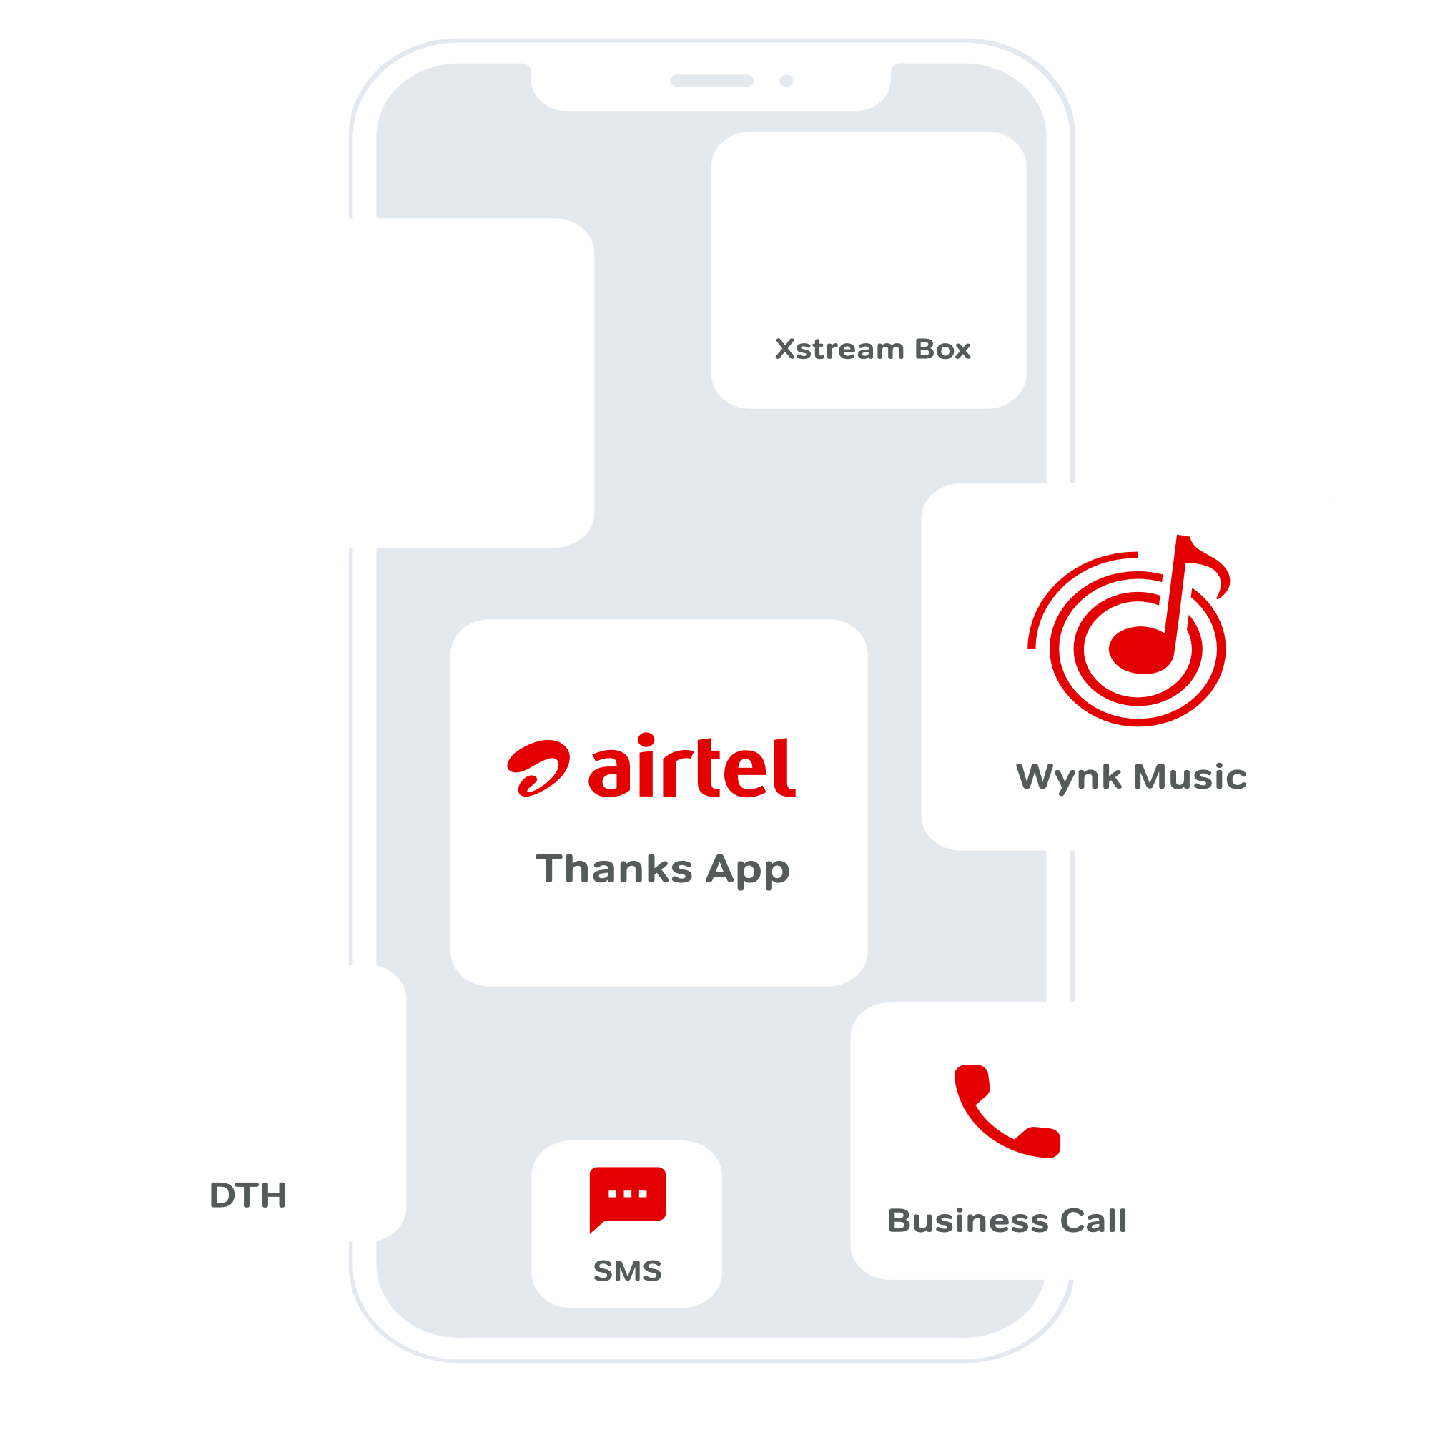
Product portfolio

Slide 10
Thank you ...

